Slide 1
Workshop
Can we characterise Aotearoa New Zealand’s research data at scale?
Notes:
SPEAKER: NICK
SHOULD BE 4:35 PM when we hit this

Slide 2
Introducing the Aotearoa New Zealand context

Slide 3
CoDiR - Aotearoa NZ Committee on Data in Research
National forum first convened - January 2022
Founding committee established - July 2022
experts, communities, and organisations involved in the production, measurement, collection, storage, and use of data in research
support delegates to CODATA, WDS, and RDA, facilitating and developing relationships with working groups, task groups, and interest groups working in national and international organisations on data oriented projects
https://dir-aotearoa.github.io/committee/members/

Slide 4
Research Data Landscape study
Limited mapping of data landscape available in Aotearoa
Some have been undertaken but all have major gaps
Māori issues remained largely unaddressed - mātauranga Māori and Māori data sovereignty
Thus:
Identified need for Aotearoa data landscape review

Slide 5
Focus of Aotearoa Landscape Review
Good examples, from overseas
Suggest some key areas of focus on:
“Institutional” (interpret broadly) situation in the data landscape
Current state assessment
Key challenges and opportunities
but need Aotearoa-centric basis
Māori data sovereignty key areas to guide review

Slide 6
Research Data Landscape Themes
Māori data sovereignty, Te Tiriti & resilience (Tahu Kukutai)
Data infrastructures, (eco)systems & cultures (Nick Jones)
Education, professional development, people/skills (Andrew Lensen)
International, national and regional collaboration (Richard Hartshorn)
Citizen science & community participatory data governance (Rogena Sterling)
Carpark

Slide 7
Attempting to quantify…. in Aotearoa
Estimate of:
Volume of unique data held for future access in managed data services?
Volume of unique data available through open access services?
Volume of unique data in services promoted as suitable for sensitive data - meeting ethics and privacy requirements?
Volume of unique data that has Māori kaitiakitanga?
Total storage volume consumed to support the above research data (including replications etc)?
Universities
CRIs
National Infrastructure

Slide 8
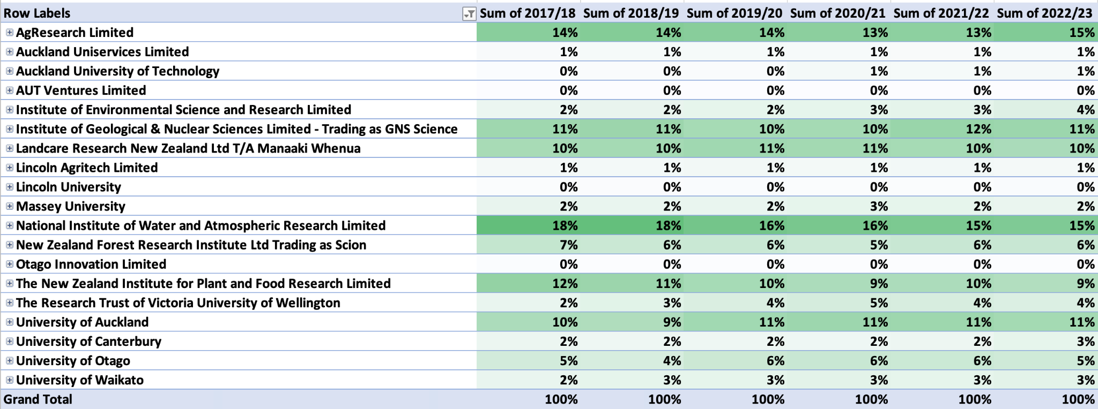
Contestable funding ratios for Aotearoa New Zealand for the last 6 years
*
*
*
Source: MBIE, excludes HRC and RSNZ funding

Slide 9
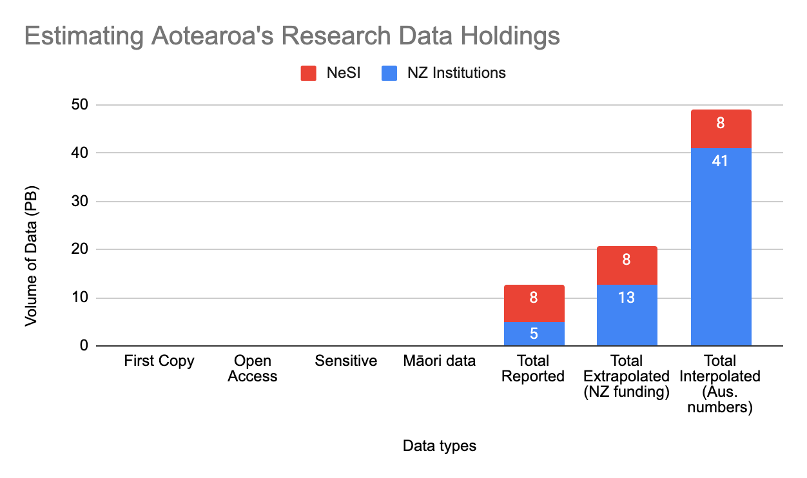
Attempting to quantify…. in 2022
Estimate of:
Total storage volume consumed to support the above research data (incl. replications etc)
?
?
?
?
Notes:
No one could answer these questions, we had short time frames and everyone thought it was worth having a go
Assumptions - We asked the questions of Institutions that make up 38% of the contestable research funding, this is how we got the NZ funding estimate. We also said If NZ is 16% of AUS gdp (1.553 trillion USD (2021) vs 249.9 billion USD (2021)), there should be 48 PB of data, if its the same ratio, so where is it?
NeSI reported total data is a double count of some data
Niwa 15% plus 38 for everything else

