Slide 1
Reporting publication quality
Faculty of Creative Arts and Industries
Drawbridge, J. (1983) City [Mural], University of Auckland Art Collection
Notes:
This presentation is designed to support the resources “Reporting publication quality (for the ) Faculty of Creative Arts and Industries. This is an online resource available on figshare
Links for this presentation are included at the end.

Slide 2
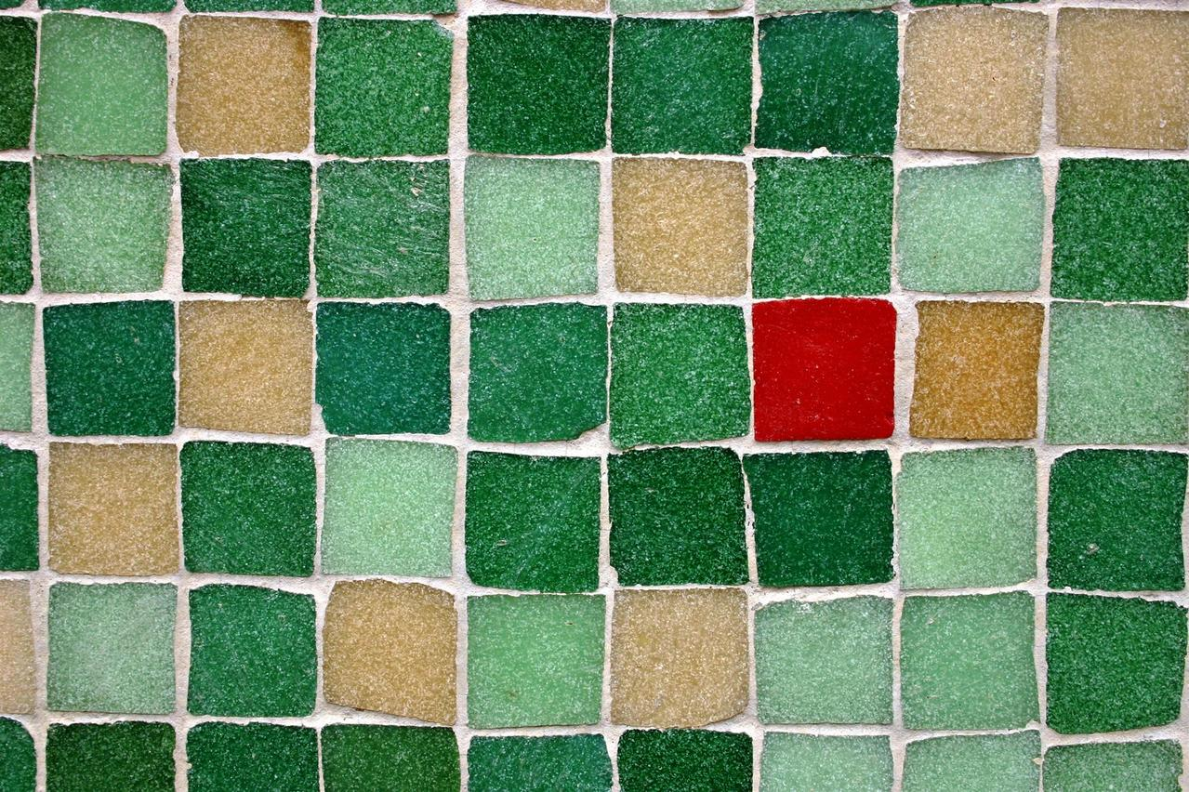
Publication quality and/or rankings for the Creative Arts & Industries
One size does not fit all
Photograph by Vullioud Pierre-Andre (FreeImages)
Notes:
Standard metrics are often not captured for the journals/publications aligned to the creative industries
This presentation will be going over:
Journal level metrics/assessments of quality – Ulrichsweb: Scimago, Journal Citation Reports, Google Scholar journal metrics: Subject lists
Supplementary data sources – Article level metrics - citations articles and chapters Google scholar: Book impact guide: Library catalogues
Alternatives to standard article-level metrics – Open Syllabus project: Altmetrics

Slide 3
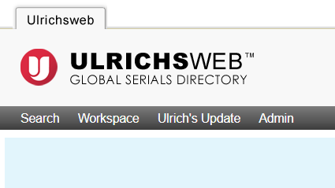
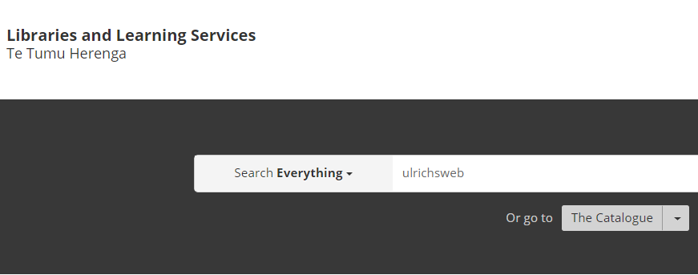
Ulrichsweb
Publisher contact & publication status
ISSN
Language
How reviewed
Frequency
Coverage by indexing and abstracting services
Notes:
Ulrichsweb is an international directory periodicals and very useful in finding out the details about the publication you have had a research output published in
Importantly entries provide full title information – of this it is the indexing coverage which will be the most useful if you cannot find standard metrics for your journal.
For example : Architecture New Zealand – this is considered a trade publication but is indexed by RIBA (Royal Institute of British Architects) & Avery so well recognised and considered within the discipline.
Find Ulrichsweb by using the “search everything” function in the library home page
Search by title or ISSN
ISSN = International Standard Serial Number. 8 digit standard identifier assigned to a periodic title

Slide 4
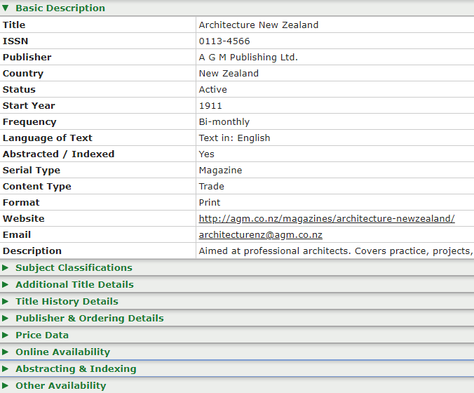
Ulrichsweb example
Notes:
Example: Architecture NZ
Provides full title information
Drop down abstract and indexing to see where indexed
I would bookmark this page and come back to it and utilise the abstracting data if the rankings you do find seem a little poor and not reflective of disciplinary standing.

Slide 5
Standard journal-level metrics
Journal Citation Reports (JCR)
SCImago
Google Scholar journal metrics
Photo by Mike Szczepanski on Unsplash
Notes:
Journal level metrics are assessing the “quality” or “standard” or “rank” of a journal or serial publication. They assess the journal overall not any single article – it is part of a wider view relating to research impact.
There are three main sources for standard journal –level metrics
Journal Citation Reports (JCR) – Web of Science tool
Scimago – Scopus tool Journal & Country Rankings
Google Scholar journal metrics
Standard journal metrics designed and best suited for the STEM disciplines do not align or, for the most part, are even available for the creative disciplines.
That being said there has been some expansion within the two main science databases – Scopus and Web Of Science, and they are beginning to index some journals that fall under CAI discipline subject headings.
This is still a developing and ongoing expansion – if your journal is not found in these tools then you will need to look further to get a “statement” of quality for it.

Slide 6
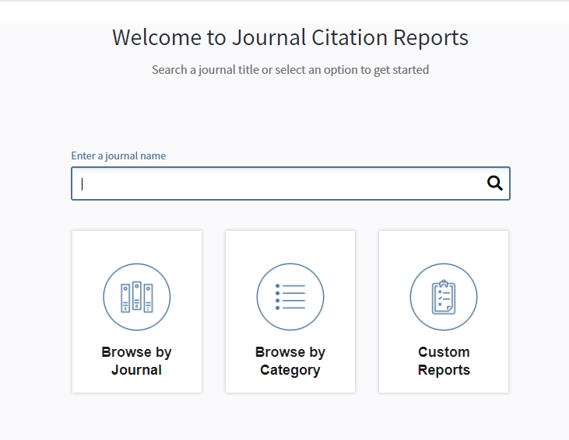
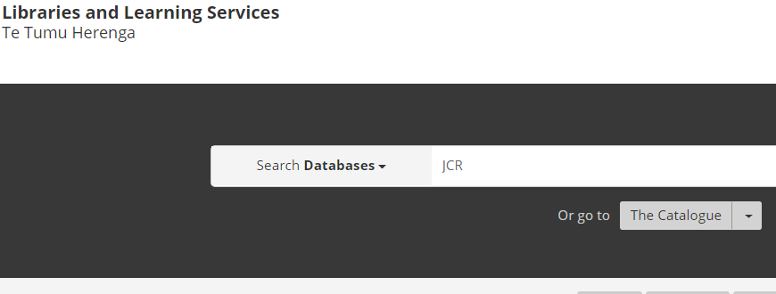
Journal Citation Reports
Journal Citation Reports (JCR)
Journal Impact Factor
Scimago
Google Scholar journal metrics
Notes:
Journal Citation Reports (JCR)
Limited number of journals relating to CAI – mostly planning and architecture
Search by Journal ISSN or title
Can also use category to find potential journals to publish in…
This tool will provide a Journal Impact Factor (JIF) and the workings for the metric
Find by selecting “databases” on the library search and search JCR

Slide 7
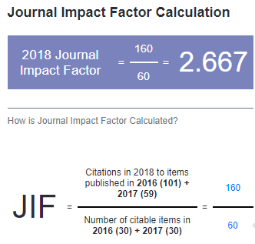
JCR example
Notes:
Example : Journal of Planning and Education Research
There is a lot of data on the metrics collected for publications – what you are wanting is the JIF

Slide 8
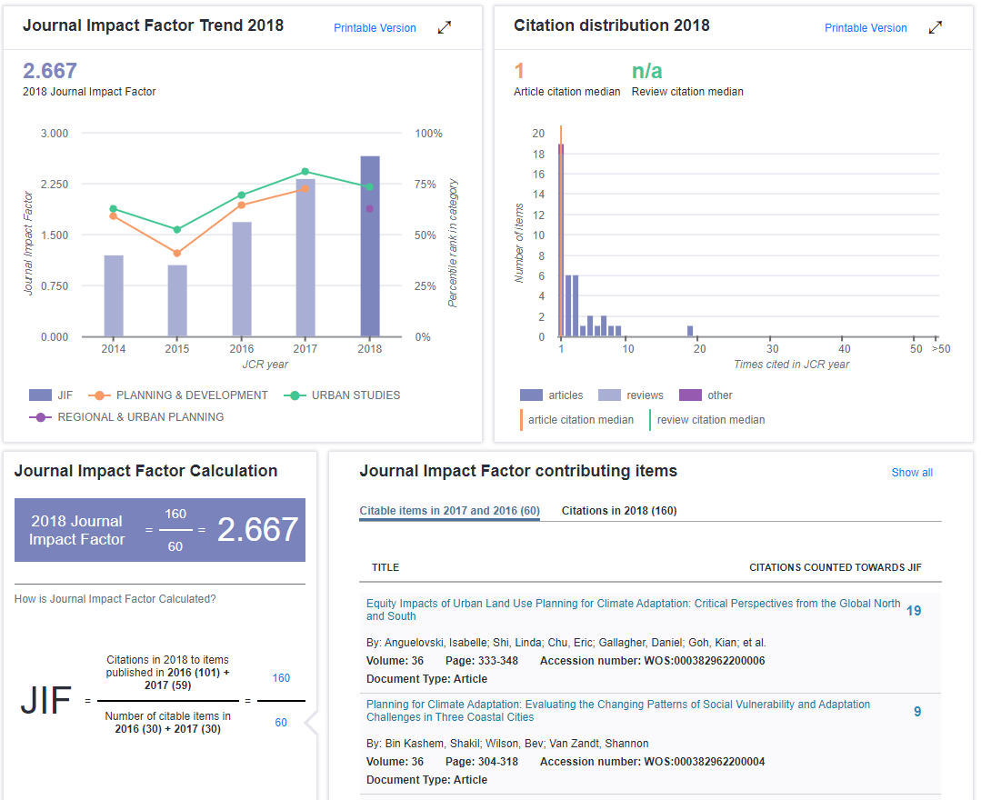
JCR example contd.
Also displays
Key indicators (year)
Journal source data (year)
Contributions by country/region
Contributions by organizations
Notes:
The whole page is larger than this and also contains
Key indicators (year)
Journal source data (year)
Contributions by country/region
Contributions by Organizations

Slide 9
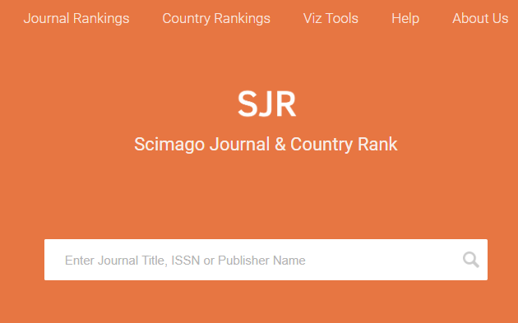
SJR - SCImago Journal & Country Rank
Discipline specific
Quartile
(e.g. Q1 is top 25 %, Q2 is second etc.)
SJR (SCImago Journal Rank)
h index
citation Reports (JCR)
Google Scholar journal metrics
Notes:
Scimago – Scopus tool – contains more journals than JCR.
Data is sourced from Scopus but SCImago is an independent visualization company
Rankings are discipline specific and can be within broad subject headings – Scopus is regularly increasing the number of journals indexed. So what may not have been there in the past may have been included in indexing today.
Search by journal title ISSN or publisher name to see if/where journal ranked.
Provides discipline specific indicators:
Best quartile numeric (e.g.Q1) https://researchassessment.fbk.eu/quartile_score
SJR (SCImago Journal rank)
H index – discipline specific.

Slide 10
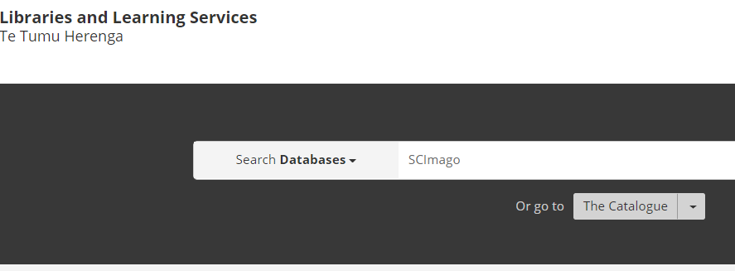
SCImago Journal & Country Rank
Step 1
Step 2
…etc…etc…
[See last line of database abstract]
Notes:
Finding Scimago tool:
Search by selecting “databases” and using scimago as search term –
this will bring up Scopus database. Look for the SCImago link in the last line of the database abstract…

Slide 11
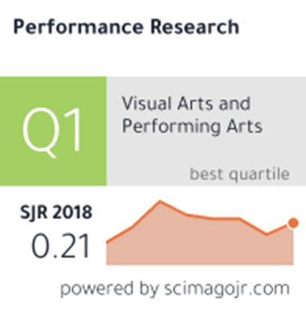
SJR example
Notes:
Example : Journal Performance Research

Slide 12
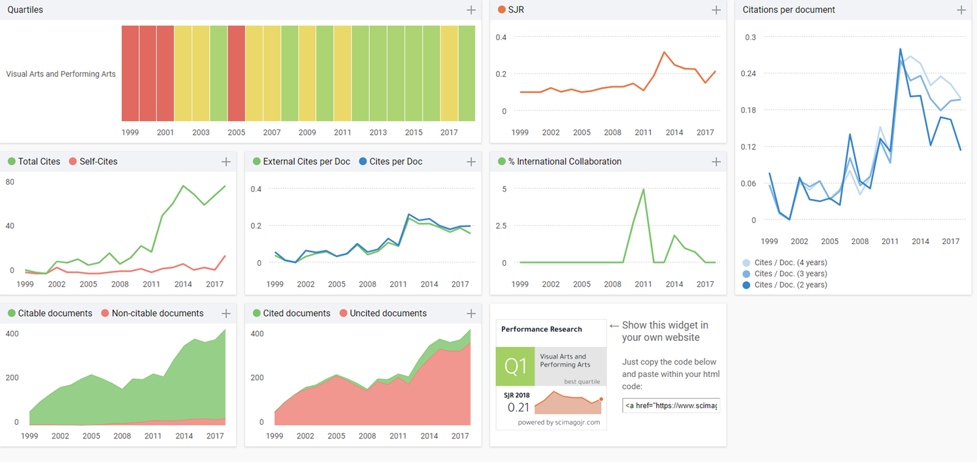
SJR example contd.
Notes:
This is what the indicator metric data looks like
You can see the quartile is discipline specific and broken down by year (1999 – 2017) – hovering over each year gives the applicable colour coded quartile
Green Q1
Yellow Q2
Red Q4
You can see this journal has steadily improved – you may want to include the URL for this page in your reporting

Slide 13
Google Scholar journal metrics
Provides h5 index
h index for articles published in the last 5 years.
i.e. The largest number (h); such that (h) articles published in the last complete 5 years have had at least (h) citations
Notes:
Google Scholar metrics are available for the last 5 years and have good coverage of disciplines beyond STEM
Metrics are for the last 5 years
Categories with sub categories allow you to filter for CAI subjects
ONLY lists the top 20 publications in each category
Provides an h5-index number which is relative to the numbers of citations applicable to a published articles within the journal over the last complete 5 years.
“h5-index is the h-index for articles published in the last 5 complete years. It is the largest number h such that h articles published in 2014-2018 have at least h citations each”

Slide 14
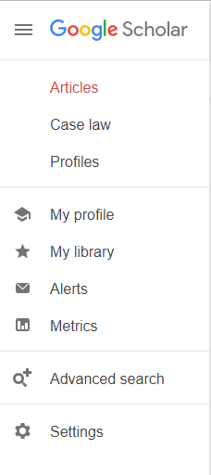
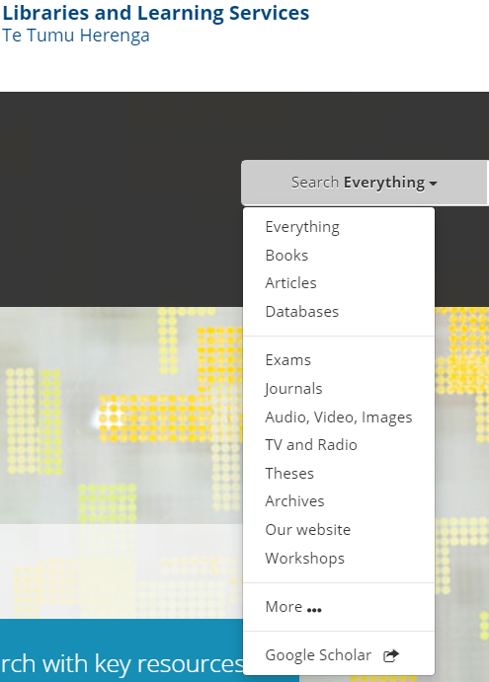
Google Scholar journal metrics
Step 3
Step 1
Step 2
Notes:
Finding google scholar journal metrics
Step 1 drop down library search to direct link
Step 2 Google Scholar menu
Step 3 Metrics
Choose categories and sub categories to filter for CAI subjects

Slide 15
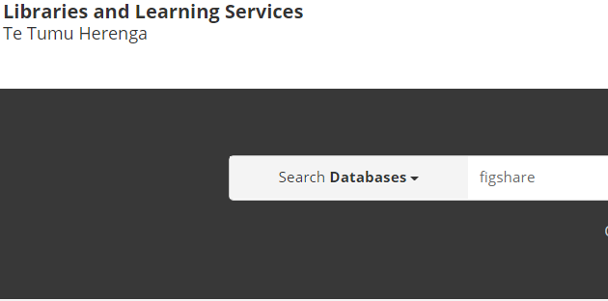
Subject Lists
ERA 2018 Journal List
Journals have already met specific quality criteria in order to be included, therefore inclusion in list is identifier of quality
Organised by Fields of Research codes (FoR)
Excel list already filtered for CAI disciplines relative to FoR codes, deposited to figshare (search ERA 2018 Journal List)
Notes:
ERA 2018 Journal list – was developed from the Excellence in Research Australia 2018 - the Australian Research Council’s Tertiary funding round – the equivalent to NZ’s PBRF
Subject specific refine by fields of research codes (FoR)
Find via University of Auckland figshare - search ERA 2018 journal list

Slide 16
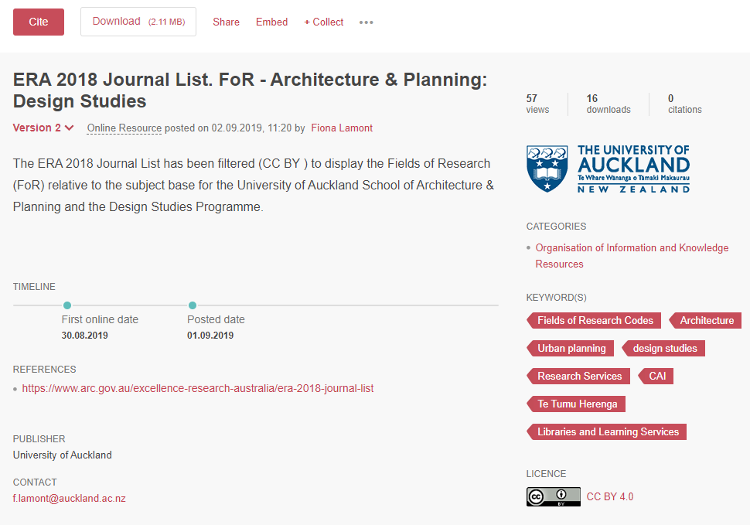
ERA 2018 Journal list
Notes:
This is the figshare page for the ERA 2018 Journal list filtered for Architecture and Planning
Not accessible via UoA/library website – [links are embedded in the resource report]
Download report - Use control “f” search function to find journal title/ISSN. Could include the URL provided by ARC (Australian Research Council) or the doi for the filtered spreadsheet
To get the doi from figshare item use the cite button and copy and paste doi from there.

Slide 17
Subject Lists
European Reference Index for the Humanities and the Social Sciences (ERIH PLUS)
Journals have already met specific quality criteria in order to be included, therefore inclusion in list is identifier of quality
Expert panel of European researchers – some crossover with CAI disciplines
Search by title or ISSN
Notes:
The ERIH PLUS is a journal index for the humanities and social sciences produced by the European Science Foundation and developed by expert panels of European researchers. There are some subject crossovers with the CAI disciplines so may be useful. It has specific criteria for inclusion to maintain the quality of the index.
Minimum requirements are:
• Publication history of at least two years
• Independent peer review
• Listed editorial board affiliations
• ISSN
• Original articles accompanied with abstracts
• Author affiliations for all scholarly articles for the last two years of publication
• No more than two thirds of published authors are from the same institution (authorship determined by reviewing last two years of published issues

Slide 18
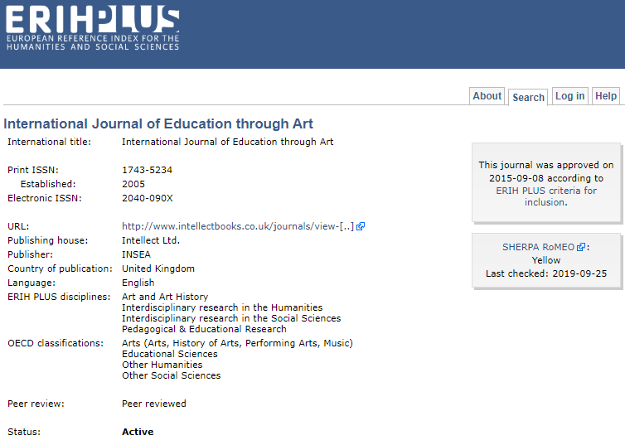
ERIHPLUS example
Notes:
Example: International Journal of Education through Art
This has been included in the ERIH Plus Journal list since 2015. – you could also include the URL
https://dbh.nsd.uib.no/publiseringskanaler/erihplus/periodical/info.action?id=477526

Slide 19
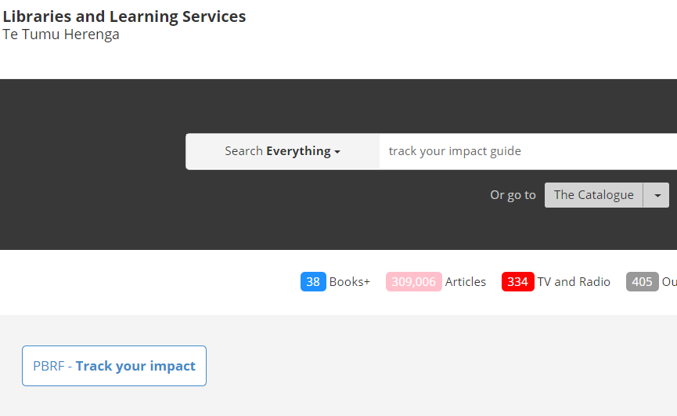
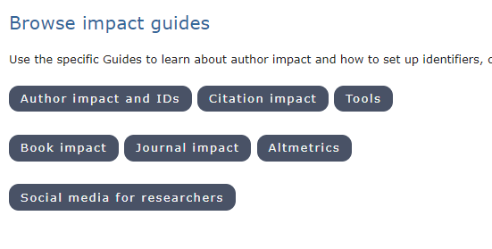
Guides for Impact
Access subject lists and tools
Step 1
Step 2
Step 3
Notes:
Ho w do you get there?
Step 1 – library search select “everything” - search term Track your impact guide
Step 2 – select Journal impact from track your impact guide
Step 3 - select lists by subject
NOTE ERA List on Library website is 2015 so outdated …

Slide 20
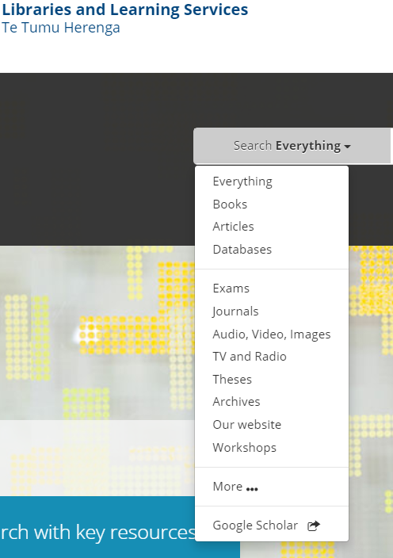
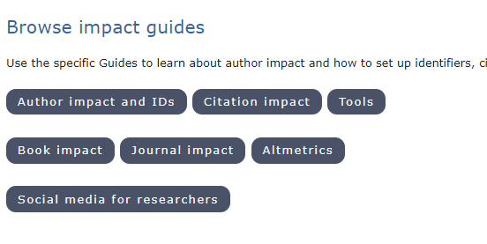
Supplementary data sources Article-level metrics
Citations (articles/chapter)
Google Scholar
Search by title, author
“Cited by (count)”
Book Impact guide
Book reviews [document type “review”]
Library ownership (Worldcat & Te Puna)
Includes additional approaches
from: Track your impact guide
Notes:
ARTICLE Level metrics are just for a single article/chapter
So if you feel information/data is lacking these metrics could help create a fuller picture of your output
But as we are aware - citations are not a key indicator of research impact for CAI disciplines – recommendations are for CAI are that Google has best coverage
To find use drop down on library home page
Search for article title or author
Books
Make sure document type is review for book reviews
All links are embedded in document

Slide 21
Alternatives to standard article-level metrics
Open Syllabus Project (OSP)
Open Syllabus Explorer
Rank: calculated against all titles in collection
Appearances: how many syllabi an article is used for -
similar to citation count
Score: the frequency a title is used relative to other titles in collection
Notes:
As part of a larger impact story, alternative metrics can help capture elements relating to impact, outcomes and uptake
Open Syllabus Project (OSP) - Shows where and how often your work has been used in tertiary teaching syllabi
No differentiation between primary and secondary reading – yet
Search by Title or author

Slide 22
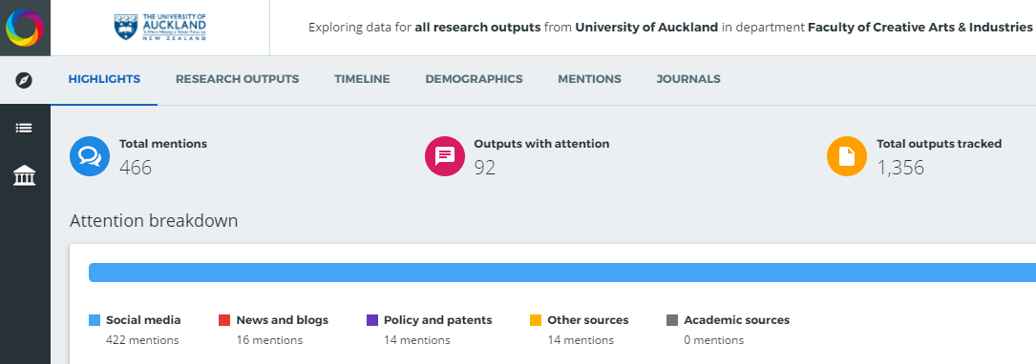
Altmetrics Non-traditional bibliometrics
Altmetric Explorer for Institutions
Single total representative of:
Record of attention: Mentions in public domain
Measure of dissemination: Where research shared
Indicator of influence and impact: e.g. Referenced in public policy documents
Notes:
Altmetric data looks to capture the attention a research output has received in the public domain.
This is whole other topic which I can go into more detail with later – like most things it can be “gamed” to improve scores - this ties into research impact strategy a later discussion
The term is also a brand name (unhelpful) and UoA has subscription to Altmetric Explorer for Institutions: this uses public APIs so work needs to be discoverable publicly to be able to receive attention.
For a single research output Altmetrics gives a single number within the colourful donut – each colour represents where attention has been sourced from ergo the colours are different for each output.
Limitations:
chapters and books not separated –
it does contain syllabi data – currently however this seemed to be lagging behind the Syllabi API so just use Open Syllabus Explorer tool.

Slide 23
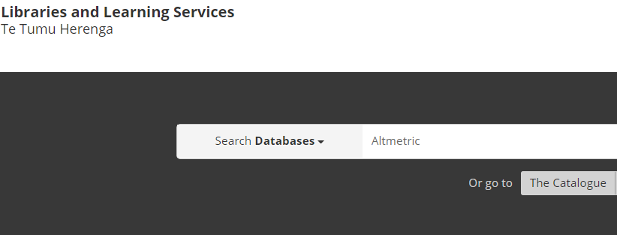
Altmetrics
Altmetric Explorer for Institutions
Notes:
Finding Altmetric explorer..
Library search drop down databases search term Altmetric
Search using quick search for single author/title
Edit search gives advanced search option

Slide 24
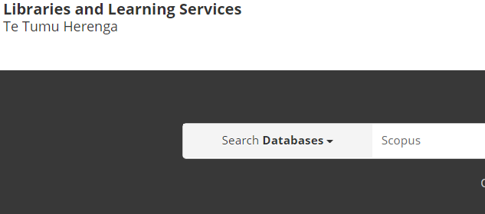
Altmetrics
PlumX Metric
Visible in Scopus database only
Citations
Usage
Captures
Mentions
Social Media
Macken, M. (2018). Binding Space: The Book as Spatial Practice. London, UK: Routledge
Notes:
Another Altmetric indicator is Plum Analytics from Scopus
We don’t have a subscription to this tool but it is visible in the Scopus database
PlumX Metrics Altmetrics indicator shows five indicators:
Citations
Usage
Captures
Mentions
Social Media
If you have anything there are any metrics available its organic shape reflects (in size) the value of the 5 indicators. Currently very limited for CAI
Search by title or author

Slide 25
Resources & links
Reporting publication quality
Lamont, Fiona (2019): Reporting publication quality - Creative Arts and Industries. figshare. Book.
https://doi.org/10.17608/k6.auckland.9809981.v1
ERA 2018 Journal List: Architecture & Planning: Design
Lamont, Fiona (2019): ERA 2018 Journal List. FoR - Architecture & Planning: Design Studies. figshare. Online resource.
https://doi.org/10.17608/k6.auckland.9750944.v2
ERA 2018 Journal List: Fine Arts: Music: Dance
Lamont, Fiona (2019): ERA 2018 Journal List. FoR - Fine Arts: Music: Dance Studies. figshare. Online resource.
https://doi.org/10.17608/k6.auckland.9750971.v3

Slide 26
Resources & links
SCImago
https://www.scimagojr.com/index.php
ERIHPLUS (European Reference for the Humanities)
https://dbh.nsd.uib.no/publiseringskanaler/erihplus/
Track Your Impact Guide
https://www.library.auckland.ac.nz/guides/track-your-impact
Journal Impact Guide
https://www.library.auckland.ac.nz/guides/track-your-impact/journal
Open Syllabus Explorer
https://opensyllabus.org/

Slide 27
Resources & links
Altmetric Explorer for Institutions
https://www.altmetric.com/explorer/highlights
Citation Impact Guide
https://www.library.auckland.ac.nz/guides/track-your-impact/citation
Book Impact Guide
https://www.library.auckland.ac.nz/guides/track-your-impact/book
Journal Citation Ranking and Quartile Scores (explained)
https://researchassessment.fbk.eu/quartile_score
Notes:
I will put this presentation up on figshare.

Slide 28
Fiona Lamont, Research Services Adviser (Creative Arts & Industries)
Te Tumu Herenga / Libraries and Learning Services
(09) 923 8655
f.lamont@auckland.ac.nz
Notes:
Thank you – any queries please feel free to contact me directly

