Slide 1
Scale Analysis: Unidimensional reliability
HSE Psychometric School August 2019
Prof. dr. Gavin T. L. Brown
University of Auckland
Umeå University

Slide 2
Creating a scale
A set of indicators (Multiple Indicators)
Ideally
Items grouped in terms of similar content
Items correlate with each other hang together
Items capture different facets of a construct
Strength of score can be used to describe people

Slide 3
Reliability Assumptions
Everyone should get or give the same response to all items even when readministered
No learning/remembering takes place between administrations
Imagine brainwashing between administrations
All scores contain random error X=T+e
(X=manifest score; T=latent true score; e=latent error)
Reliability = σ²_{T} / σ²_{X} : The exact value of e is unknown
Change in Error will effect reliability
Unidimensionality is assumed; if a scale is known to be multidimensional (or factor analysis demonstrates some divergence from unidimensionality) then each subscale is estimated separately.

Slide 4
Scale reliability
The degree to which a set of items consistently measures a construct
Multiple approaches include
Agreement within a set of items (internal estimate of reliability)
Multiple estimators of agreement: Split-half, median item inter-correlation, etc.
Consistency of responding across times (test-retest reliability)
Correlation between times in a repeated measurement
Consistency between judges or raters
Inter-rater reliability

Slide 5
Test-retest (parallel test)
rXY=1 represents a perfect correlation between time X and time Y
But random error still exists so rXY≠1
Less error in each score means the correlation between T scores will be higher
Parallel tests are independent repetitions of the same test under the same circumstances
Requires similarity of
the score AND the variance
Reliability is correlation between X and X’
But difficult to obtain such data
Who wants to give the same test twice in 3-6 weeks?

Slide 6
Internal estimates
Cronbach’s alpha
The median inter-item correlation using data from a single administration
Equivalent to
KR20 for dichotomous items
Guttman’s λ₃
Alpha≤rXY
Lowest estimator of the lower bound of inter-item correlation
We are estimating the bottom end of a range of reliabilities (Sijtsma, 2009)

Slide 7
alpha
Alpha is the essentially tau-equivalent model
constant item variances for the true scores
true score means and the error variances of the items vary
Assuming the true score variance (equal sensitivity) is constant across all items is improbable & unrealistic. Hence, alpha is an inappropriate measure of internal consistency reliability
where essentially tau-equivalence assumptions are violated, estimation of reliability of alpha is lower than the population (i.e., true) level of reliability
alpha tends to underestimate the degree of internal consistency of a scale when errors are uncorrelated.
reliability of alpha can also be inflated when
the errors for each item are correlated or the number of items is significantly increased
difficult to gauge the magnitude, direction, or even the source of any bias.

Slide 8
Alpha if item deleted
Can be used to identify deviant items
assumes equal error variance across all items which is contrary to essentially tau-equivalent assumptions in calculating alpha in the first place
BUT
Sample dependent. Increases alpha in this sample but not necessarily the population

Slide 9
GLB
greatest lower bound (glb)
represents the smallest reliability possible given observable covariance matrix C_{X} under the restriction that the sum of error variances is maximized for errors that correlate 0 with other variables.
data from one test administration restricts the real reliability to the interval [glb, 1]. This means that when the glb is found to be 0.8, the true reliability has a value in the interval [0.8; 1]
Access
Not in SPSS
Implemented in TiaPlus from CITO (Netherlands) free upon request

Slide 10
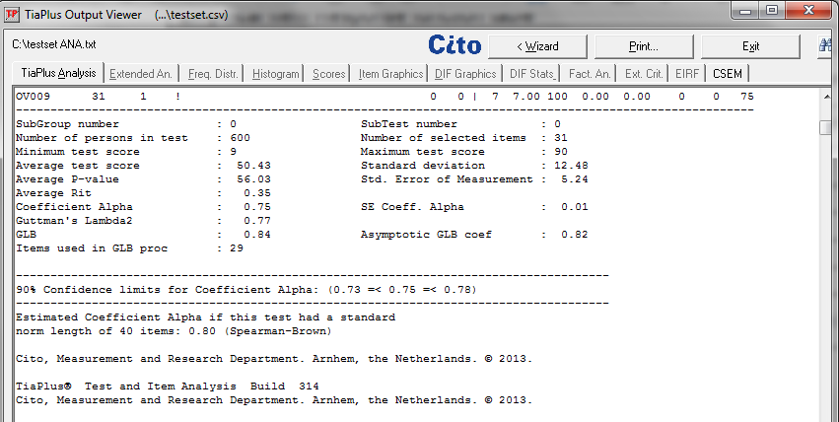
TiaPlus
31 test items
Note.
GLB is higher than alpha and Lambda2

Slide 11
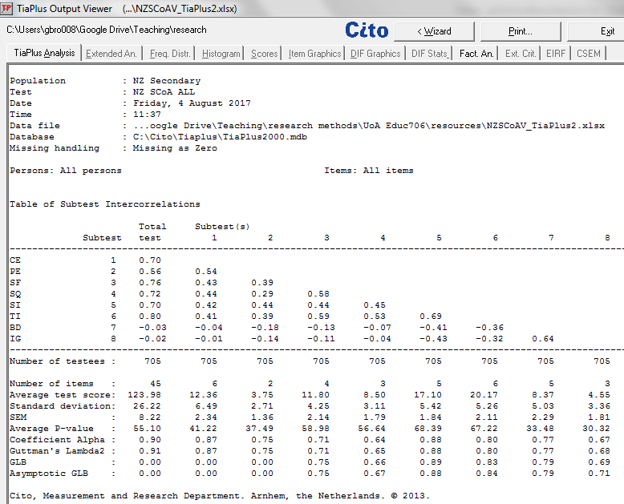
SCoA
Tiaplus reliability
Demo with NZCOA 8 factors
NB. Not all scales provide glb
But glb≥alpha

Slide 12
McDonald’s omega
Congeneric model assumptions
Means and variances of the true scores and the error variances are allowed to vary
avoids assumptions about constant means and variances
when the assumptions of the essentially tau-equivalent model are met, omega performs at least as well as alpha.
under violations of tau-equivalence–conditions likely to be the norm in psychology– omega outperforms alpha
Problems associated with inflation and attenuation of internal consistency estimation are far less likely.
‘omega if item deleted’ in a sample is more likely to reflect the true population estimates of reliability through the removal of a certain scale item.
Available in R, JAMOVI, JASP

Slide 13
Conventional thresholds
Critical values of estimates
> .9 ➔ use for highest stakes possible
(consistency relationship explains 81% or more of variance)…
do you really need both measures /markers since they are identical?
> .8 ➔ publish assessment
(consistency relationship explains 64% or more of variance)
> .7 ➔ classroom teacher use only; research OK
(consistency relationship explains 49% or more of variance)
< .6 ➔ random noise
(consistency relationship explains less than 36% of variance)

Slide 14
Ordinal rating scales
The transition from each rating option to another is called a threshold
There are #Options-1 thresholds
Thresholds should be ordered (not jumbled) to indicate that with increasing overall endorsement of the item the probability of choosing a higher ordered option increases; that is there is linearity
The probability of choosing an option should be high enough to justify having the option as a rating point
The distance between peaks of threshold options should be reasonably equivalent to claim that the measurement is at least interval

Slide 15
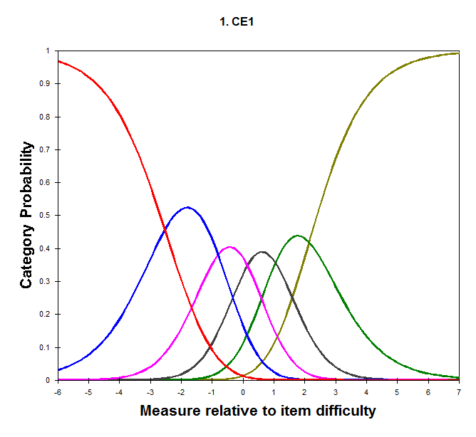
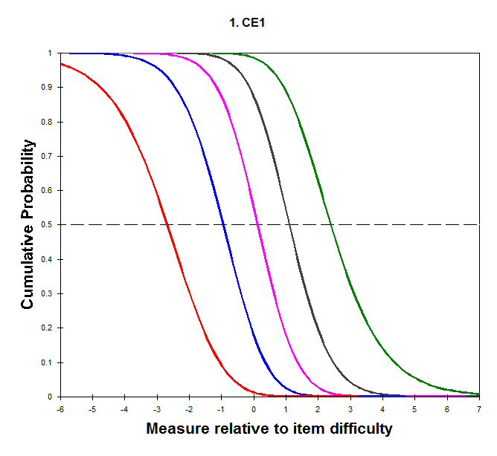
CE1 Response Category Information
Threshold curves
Left side= very high probability of being at this threshold for that overall level of agreement
Note. Distances of mid-points are nearly equal
Desired p
Actual p

Slide 16
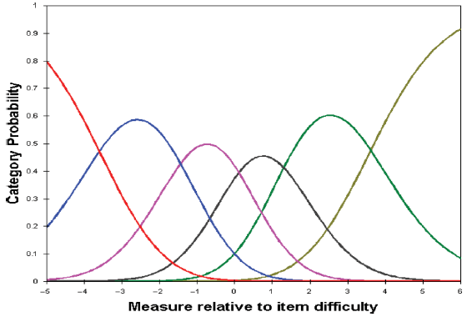
Response thresholds of polytomous rating scale
This plot shows the average across all items
Andrich’s Rating Scale Model
Determined in WinSteps
Deneen, C., Brown, G., Bond, T., & Shroff, R. (2013). Understanding outcome-based education changes in teacher education: Evaluation of a new instrument with preliminary findings. Asia-Pacific Journal of Teacher Education 10.1080/1359866x.2013.787392
Each line = probability of choosing that rating category relative to overall endorsement of the construct

Slide 17
Ordinal rating scale
Most attitude scales have rating options
Likert: Strongly Disagree, Disagree, Neutral, Agree, Strongly Agree
Problematic because so little discriminatory power
Positively Packed: Strongly Disagree, Mostly Disagree, Slightly Agree, Moderately Agree, Mostly Agree, Strongly Agree
Negatively Packed: Strongly Disagree, Mostly Disagree, Moderately Disagree, Slightly Disagree, Mostly Agree, Strongly Agree
So the calculation has to adjust each item for which rating option selected

Slide 18
Reliability of a scale
How closely do they hang together
But
Do they create a rank order of easy to agree to hard to agree or do they just clump together?
Rasch analysis can help

Slide 19
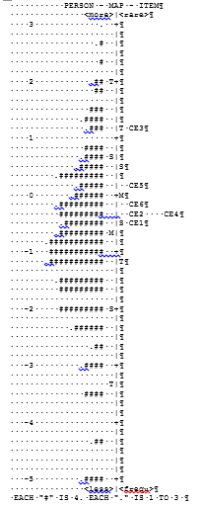
Order of items in a scale
What language would describe this space?
Our class becomes more supportive when we are assessed
Assessment makes our class cooperate more with each other
Assessment encourages my class to work together and help each other
What language would describe this space? So people can say YES instead of no…
This analysis can be used to evaluate if additional items for a construct are needed

Slide 20
Summary
Scale analysis
A weak alternative to CFA to prove that items can be aggregated into a common structure
But almost always required by journals
Rasch model approach to developing items for scale has validity
Mimics ‘ideal point’ scale development (unfolding models) but mathematically much simpler
But rarely implemented this way

Slide 21
What they do
Simplify multiple variables into fewer dimensions, vectors, or pools of highly correlated/covarying variables
Instead of reporting multiple items, we report one factor score and improves confidence in interpretations
The weight of multiple measures ensures better estimation of opinion or attitude or ability
The factor reduces chance effects and error
Exploratory
When you don’t know what or how many factors are present
Confirmatory
Explicitly tests a known number and structure of factors

Slide 22
But….
For example, many researchers advocate the use of structural equation modelling (SEM) as the most robust tool to assess a test’s reliability, mainly, because it allows one to specify and compare different models of reliability (e.g., Graham, 2006; Miller, 1995; Yang & Green, 2011). The current authors are aware that such methods as latent variable modelling outperform current analyses of reliability; however, this will rarely be the most appealing approach for the majority of researchers and users of psychometric scales. SEM for example demands large sample sizes, and it may also be impractical in the sense that it requires considerable expertise to employ correctly. (p. 400)
Dunn, T. J., Baguley, T., & Brunsden, V. (2014). From alpha to omega: A practical solution to the pervasive problem of internal consistency estimation. British Journal of Psychology, 105(3), 399-412. doi:10.1111/bjop.12046

Slide 23
Getting Started with analysis
Data; Jamovi; RStudio

Slide 24
Introduction to Data File for Guided Practice: Student Conceptions of Assessment v6

Slide 25
Students’ Conceptions of Assessment
Students see assessment through their different roles and responsibilities in the process
Assessment makes Students, Schools & Teachers Accountable.
Assessment is Irrelevant, Bad, or Unfair
Assessment Improves Teaching and Learning
Assessment is Emotionally & Socially Beneficial
Brown, G. T., Irving, S. E., Peterson, E. R., & Hirschfeld, G. H. (2009). Use of interactive–informal assessment practices: New Zealand secondary students' conceptions of assessment. Learning and Instruction, 19(2), 97-111. doi:10.1016/j.learninstruc.2008.02.003
Weekers, A. M., Brown, G. T. L., & Veldkamp, B. P. (2009). Analyzing the dimensionality of the Students' Conceptions of Assessment (SCoA) inventory. In D. M. McInerney, G. T. L. Brown & G. A. D. Liem (Eds.), Student perspectives on assessment: What students can tell us about assessment for learning. (pp. 133-157). Charlotte, NC US: Information Age Publishing.
Brown, G. T. L., Peterson, E. R., & Irving, S. E. (2009). Beliefs that make a difference: Adaptive and maladaptive self-regulation in students’ conceptions of assessment. In D. M. McInerney, G. T. L. Brown, & G. A. D. Liem (Eds.), Student Perspectives on Assessment: What Students can Tell us about Assessment for Learning (pp. 159-186). Charlotte, NC: Information Age Publishing.

Slide 27
Data Dictionary
SC0A Factors | Label
bd | Bad
ce | Class environment
ig | Ignore
ir | Irrelevant
pe | Personal enjoyment
sf | Student future
si | Student improvement
sq | School quality
sr | Self-regulate
sta | Student accountability
ti | Teacher improvement
val | Valid
SCoA-VI Data Sets:
The following SPSS data file contains data information that was collected in 2007 from large samples of students in a few Auckland region schools for Version 6 of SCoA. Note that Version 6 is a reanalysis of the data collected for Version 5. This SPSS file contains all relevant variables and codes as outlined within this codebook/data dictionary.
NZ SCoA-VI.sav
https://doi.org/10.17608/k6.auckland.4557322.v1

Slide 28
Variables
Assessment Definitions
An examination that takes one to three hours
I score or evaluate my own performance
My class mates score or evaluate my performance
The teacher asks me questions out loud in class
The teacher evaluates the written work I hand in
The teacher grades me on a written test that he or she made up
The teacher grades me on a written test that was written by someone other than the teacher
The teacher observes me in class and judges my learning
The teacher scores a portfolio of work I have done over the course of a term or school year
The teacher scores me on an in-class written essay
The teacher scores my performance after a conference or meeting with me about my work
The teacher uses a checklist to judge my in-class performance
Demographic
Case ID
Age of participant in years
Ethnic Group
A = Asian, M = Maori, N = Pākeha, NZ European, O = Other, P = Pasifika.
School year of participant
9 or 10
Sex
F = Female, M = Male
N=617

Slide 29
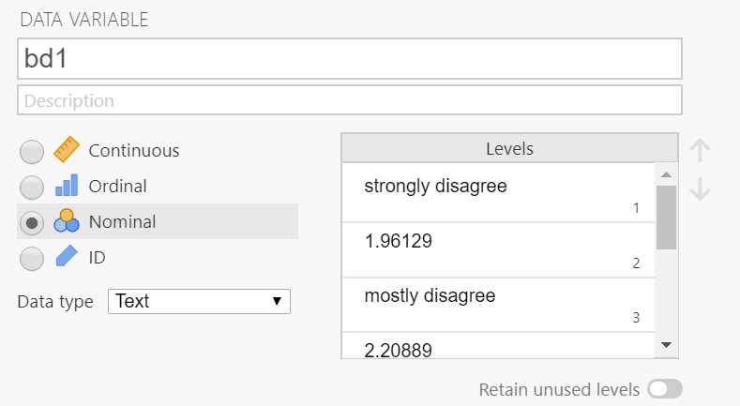
JAMOVI
Download from https://www.jamovi.org/download.html
Insert data
File>Open>navigate to where you saved NZSCoAVI.sav
Ensure all vars are ORDINAL, Decimal
Double click variable to open var info

Slide 30
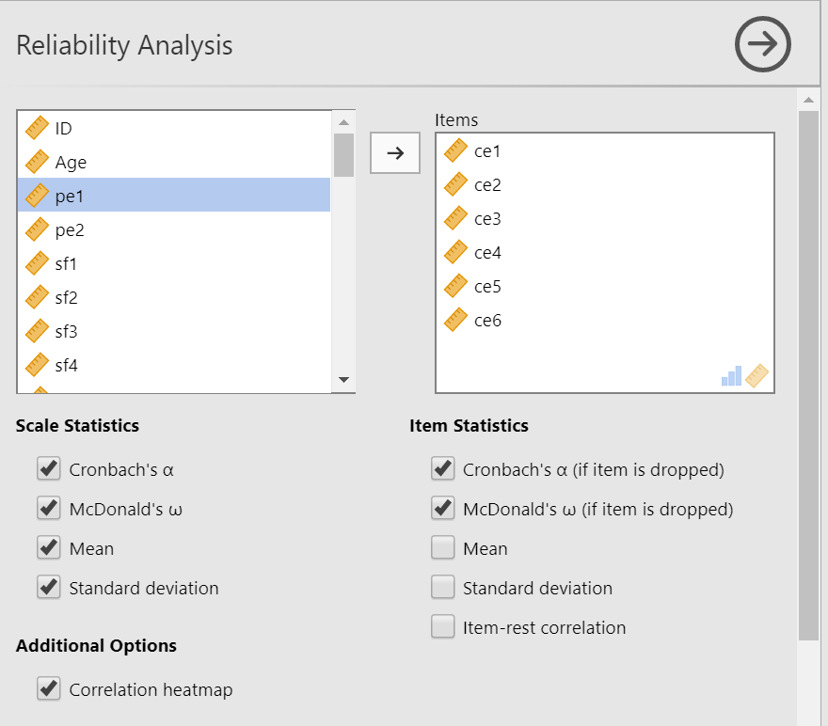
Scale analysis
Select Factor>Reliability Analysis
Select items ce1 to ce6; shift into Items box
Select Cronbach and McDonald’s to see difference
Select if item is dropped

Slide 31
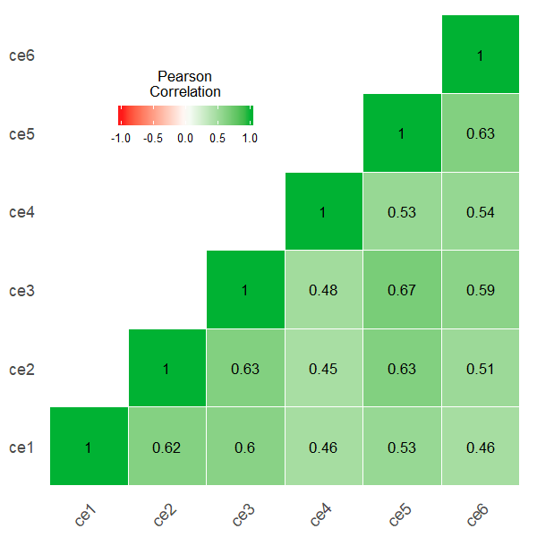
Results classroom environment
All values lower if item dropped

Slide 32
Complete the table
SCoA Scale | Alpha | Omega
CE | .881 | .883
PE
SI
TI
BD
IG
SF
SQ
Improvement (SI+TI)
Social Affective (CE+PE)
External Attributes (SF+SQ)
Irrelevance (IG + BD)

Slide 33
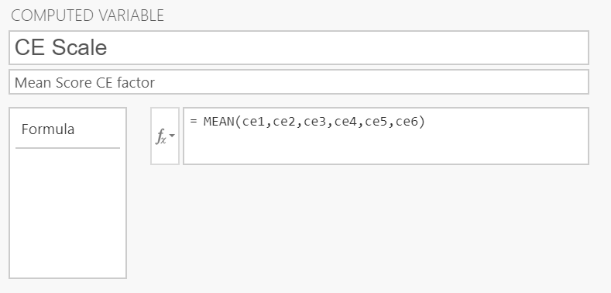
Create Scale Scores
DATA>Compute
Insert name for new variable
Click f(x) to get commands
Double-click MEAN
Insert variable names separated by commas
<<Presto calculated values appear>>
Repeat for all 8 SCoA scales

Slide 34
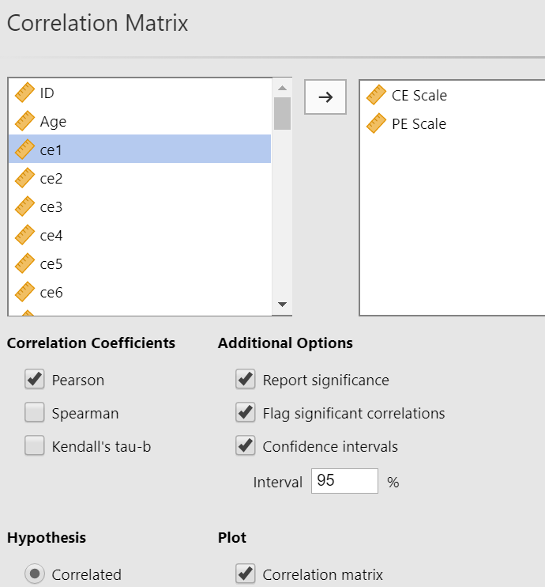
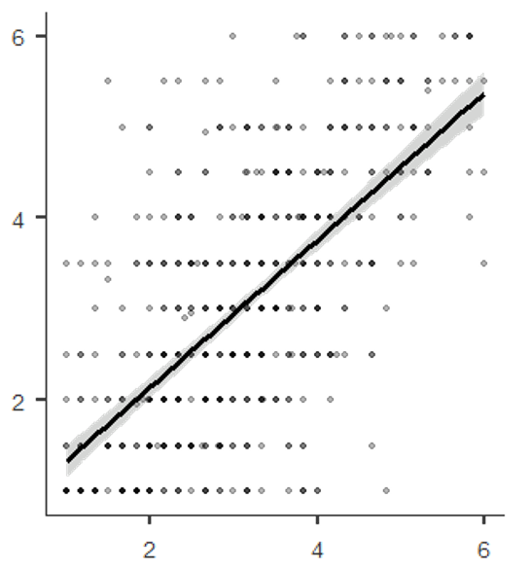
Compute Correlation
Click Regression>Select Correlation Matrix
Select variables of interest into box
Correlation: t = 21.084, df = 615, p < 2.2e-16
95 percent confidence interval: 0.5994525, 0.6913241
sample estimates: r= 0.6477369

Slide 35
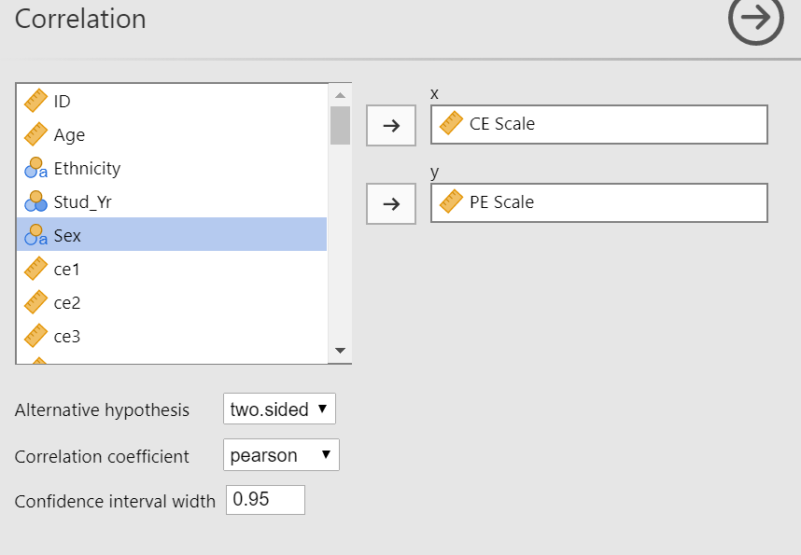
Alternate approach
Jamovi>Install Base R module
Select Correlation

Slide 36
Complete the scale inter-correlation matrix
SCoA | 1 | 2 | 3 | 4 | 5 | 6 | 7 | 8 | 9 | 10 | 11 | 12
1. CE
2. PE
3. SI
4. TI
5. BD
6. IG
7. SF
8. SQ
9. Improve
10. Social Affect
11. External
12. Irrel.

Slide 37
Evaluating Mean Differences
Practical significance indicates how large not how rare a difference is
Cohen’s d is a proportion of standard deviation
Simple to calculate and understand
d=(M₂-M₁)/((SD₂+SD₁)/2)
Scale reliability provides M and SD

Slide 38
Prepare Means Table (from Reliability)
Effect size of mean difference (Cohen’s d)
SCoA | M | SD | 1 | 2 | 3 | 4 | 5 | 6 | 7 | 8 | 9 | 10 | 11 | 12
1. CE |  |  | ―
2. PE |  |  |  | ―
3. SI |  |  |  |  | ―
4. TI |  |  |  |  |  | ―
5. BD |  |  |  |  |  |  | ―
6. IG |  |  |  |  |  |  |  | ―
7. SF |  |  |  |  |  |  |  |  | ―
8. SQ |  |  |  |  |  |  |  |  |  | ―
9. Improve |  |  |  |  |  |  |  |  |  |  | ―
10. Social Affect |  |  |  |  |  |  |  |  |  |  |  | ―
11. External |  |  |  |  |  |  |  |  |  |  |  |  | ―
12. Irrelevance |  |  |  |  |  |  |  |  |  |  |  |  |  | ―

