Slide 1
Kindness in (science)
Kate Hannah
@knhannah

Slide 2
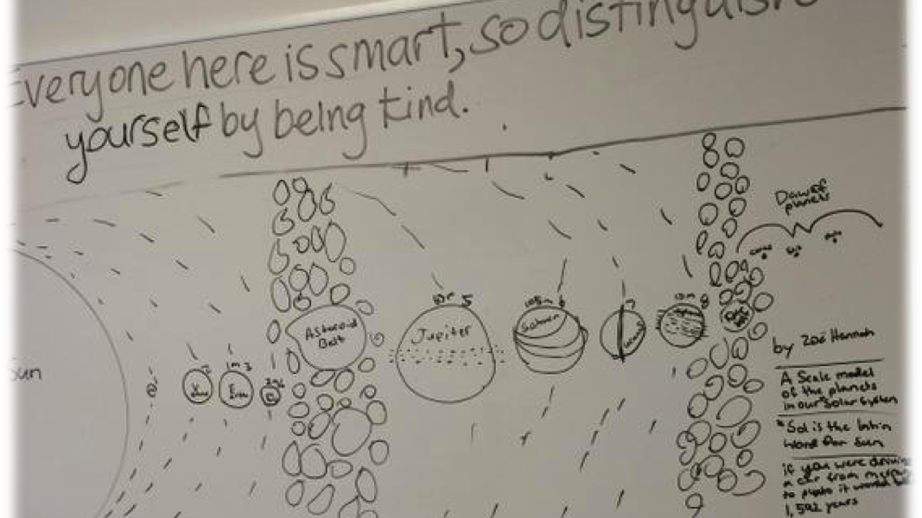
Kate Hannah’s whiteboard, diagram of the solar system, Zoe Hannah, circa 2015

Slide 3
Culture is ordinary: that is the first fact. Every human society has its own shape, its own purposes, its own meanings. Every human society expresses these, in institutions, and in arts and learning. The making of a society is the finding of common meanings and directions, and its growth is an active debate and amendment under the pressures of experience, contact, and discovery, writing themselves into the land.
Raymond Williams, ‘Culture is Ordinary’, 1958

Slide 4
A culture has two aspects: the known meanings and directions, which its members are trained to; the new observations and meanings, which are offered and tested. These are the ordinary processes of human societies and human minds, and we see through them the nature of a culture: that it is always both traditional and creative; that it is both the most common ordinary meanings and the finest individual meanings… Culture is ordinary, in every society and in every mind. Raymond Williams, ‘Culture is Ordinary’, 1958

Slide 5
I sing of warfare and a man of war.
From the seacoast of Troy in early days
He came to Italy by destiny,
To our Lavinian western shore,
A fugitive, this captain, buffeted

Slide 6
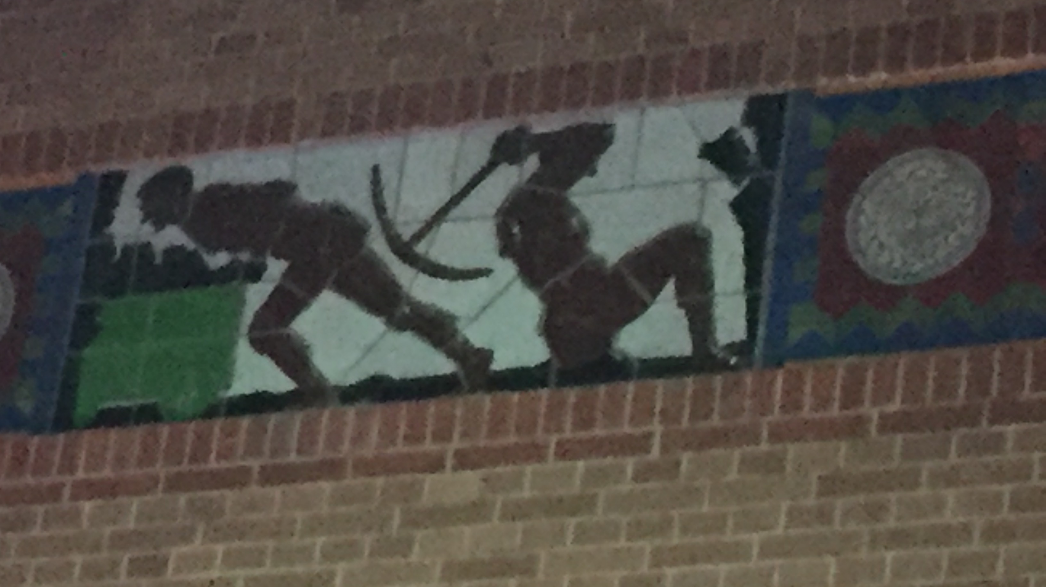
Frieze, Beurs De Berlarge, Amsterdam,I
Circa 1893-1903, image taken by Kate Hannah, 2016

Slide 7
David Mackay, 1990
https://teara.govt.nz/en/biographies/1c23/colenso-william

Slide 9
A culture has two aspects: the known meanings and directions, which its members are trained to; the new observations and meanings, which are offered and tested…

