Slide 1
Intellectual Property and
Commercialisation of Technologies at The University of Auckland
Nicola Johnstone
Head of IP
UniServices Commercialisation

Slide 2
What can UniServices Offer Students
Commercialisation Workshops – lean canvas – development of ideas
University of Auckland Investment Fund - $20M Evergreen Fund
IP assistance
Return on Science Investment Committees – advise
Start-ups – assistance, advice, funding

Slide 3

UoA IP Policy – Staff & Students
Staff
Where staff members create any IP (other than excluded works)
    in the course of their employment, or
    using University resources
  the University has rights in that IP.
  Excluded works include journal articles, books, conference papers, lecture notes
Students
  Students own IP created during a course of study at the University UNLESS there is an agreement to the contrary
  May require assignment of IP to a 3rd party as a condition of participation in a research project/activity
  Students are first owners of copyright in their theses, dissertations and other assessable work
  Both Staff and Student can benefit from technology that is commercialised by UniServices

Slide 4
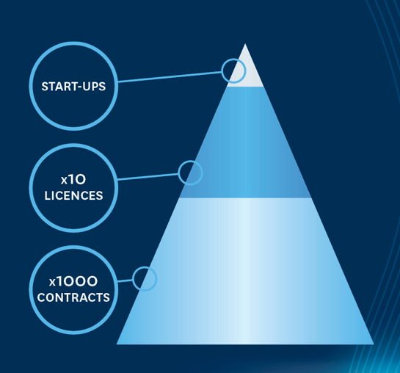
What is Intellectual Property?
An intangible asset
The product of the human creative process
May be an idea, concept, knowledge, design, a brand, reputation
The University’s IP ranges from
patents to knowhow
Investment in the IP
leads to:
  Contracts & consultancy
  Licenses
  Start-ups

Slide 5
Protecting and Commercialising Technology
Purpose
  Does the team want to commercialise?
  Or is releasing the technology for the public good preferred?
  Market
  Is there a market need for the technology that has been created?
  Does it solve a market problem?
  Patentability
  Is the technology patentable?
    Is it new?
    Is it non-obvious?
  More Research needed?
  Is there a need for more research?
  May need to coordinte research programmes with patenting and commercial plans
  Is there enough evidence (tests/proof) to support a patent application?
  What IP is the best form of protection for any product that might go to market?

Slide 6

Types of Intellectual Property
Patents protect the functionality of an invention
Registered Designs protect shape or configuration
Trade marks protect words or logos
Copyright protects expressions of ideas
Trade Secrets protect methods of manufacture/processes (assuming the owner is capable of controlling the process so it remains a trade secret)
Know-how is anything that is created (can be simply in a person’s head) during research
Example – a piece of software might have both patent and copyright protection

Slide 7
Patents
Patents provide a set of exclusionary rights to the patentee for a limited period of time in exchange for public disclosure of the invention in a patent application
Protect how something works or how it is made
Can act as a deterrent to competitors
In order to be patentable an invention/idea/technology must be:
Novel (new) – not disclosed to public
Non-obvious
Useful
IMPORTANT – you must file a patent application before disclosing to the public (incl oral presentation) or publishing!

Slide 8
Patentability Assessment
Investigate
  Existing patents
    https://patents.google.com
  Existing products
    General google searches
  Academic research/papers
Determine – is the invention novel (new)
What are the differences to prior art?
  Are those differences obvious?
Prior art

Slide 9

Copyright
Protects the embodiment of an idea rather than the idea itself
Prevents copying of artistic or written works eg. paintings, books, films, music and software
Can be bought, sold or licensed
Automatic right (free)– but should be asserted
– © Nicola Johnstone 2019
Limited term
Beware: journals often require authors to
assign copyright in articles to the journal

Slide 10
How can you get involved in Entrepreneurship?
MakerSpace at Unleash - https://www.unleashspace.ac.nz/
CIE Programmes - http://www.cie.auckland.ac.nz/
Velocity https://www.velocity.auckland.ac.nz/innovation-challenge/
Return on Science - https://returnonscience.co.nz/momentum
Notes:
There are lots of opportunities within The University of Auckland to get involved in innovation and entrepreneurship.
The first thing I would recommend you do it to sign up at the MakerSpace at Unleash – see details here - https://www.unleashspace.ac.nz/ - if you haven’t already. This is a space that student and staff can make things – and its free to access.
The Centre for Innovation and Entrepreneurship (http://www.cie.auckland.ac.nz/) also runs loads of programmes you could get involved in. One is the Velocity Innovation challenge (https://www.velocity.auckland.ac.nz/innovation-challenge/). Also the 100K challenge might be a programme you can get involved with. I understand that often teams will post (at the Unleash space) when team members are needed for these challenges. That might be a way you can get involved in an idea, even if you don’t have one yourself. There is also the Startup school, speaker series and other events that you could attend to meet like minded students.
Also, UniServices and Return on Science (https://returnonscience.co.nz/) run investment committees that you could attend – in particular, Momentum, the student run committees would be a great place to meet others who are interested in entrepreneurship and innovation - https://returnonscience.co.nz/momentum. Momentum meetings are run every month, with students taking projects to them for advice, or in some cases for funding. If you are interested in attending the next meeting – next week on Wednesday – I can organise an invite for you.

Slide 11


Slide 12
Extra Slides

Slide 13
Patents
Are country or region specific
Can be bought, sold or licensed
Provide 20 years of protection
Arguably easier to commercialise an invention if protected by a patent
    Can be licensed by existing company or start-up
    Becomes a bargaining chip

Slide 14


What is a “Public Disclosure?”
=?
Prior art
PhD or Masters theses
Conference presentation
Patent publication
Poster presentation
Books
Existing products
Website articles
Journal publication
IMPORTANT - Must protect before publishing!

Slide 15
What’s the point?
Value
Raising investment
Licensing of tech
Deterring competition in a market
Devaluing competitor tech
Sale of patent
Marketing kudos of patent
“A patent is a business asset yet has no intrinsic value on it’s own.”
“A patent only has value in the context of the business strategy that it is used to support.”
Notes:
This means that a patent alone cannot make money or create value for the holder.
Too many people believe that getting a patent granted for a technology is the key goal and will make them a billionaire
Reality is that a patent is a helpful start, but products or services still ultimately have to be sold, and the patent can be a useful tool to gain market exclusivity or provide value to a third party seeking to sell.

Slide 16
When to Protect by patent… or at all
Patents excellent tool when tech is foundational
          (Start-up company a good option here)
Will filing patents provide a commercial advantage?
    Stop/delay others entering market
Is there another form of IP that provides strategic advantages?
    Trade Secret (eg. Software, processes?)
    Rely on copyright?
Is money better spent elsewhere?
    Taking product to market quickly (apps?)
    Making continual and quick developments to product to stay ahead of competition

Slide 17
Freedom to Operate (FTO)
Different to patentability!
Determination of whether your technology infringes existing IP
FTO analysis – search plus review of patent claims
Best done once you have a minimum viable product (or something you can take to market)
Important for Start-ups to do this type of investigation before taking product to market
Can be very expensive! But is a way of reducing business risk.

Slide 18
Patentability/FTO
Novel & Inventive Feature
New Tech
A + B + C + Y
New Tech Start-up DO NOT HAVE FTO - will have to license Competitor’s patent in order to market their new tech
Can patent
Competitor’s Patent
A + B + C
New Tech infringes Competitor’s patent

Slide 19

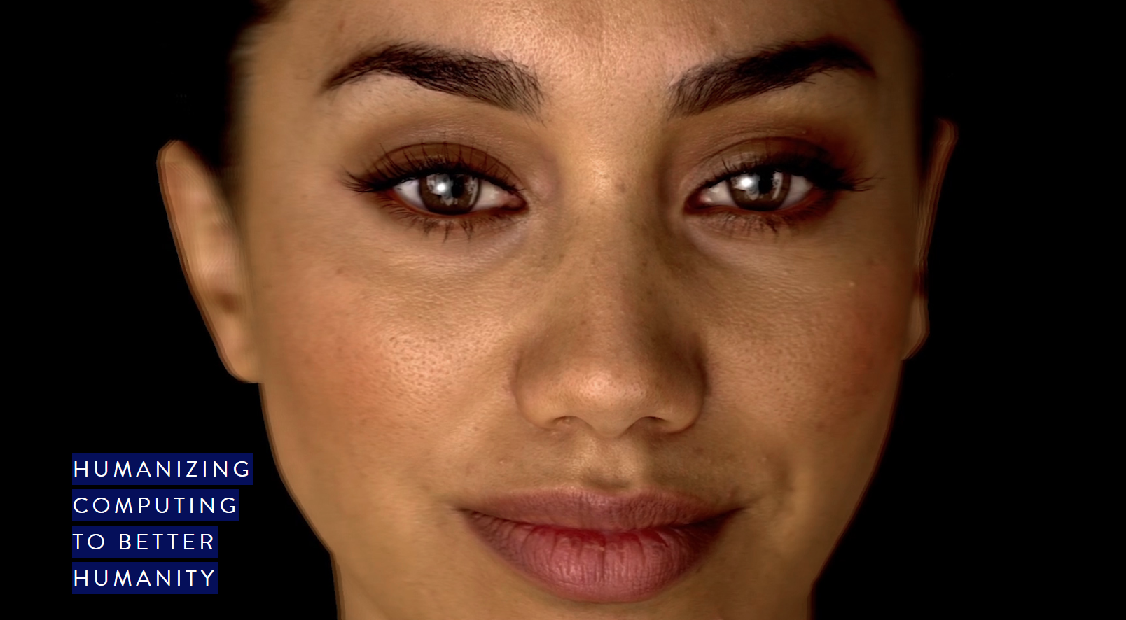
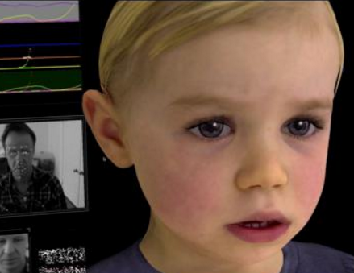

Case Study
Create life-like, emotionally responsive artificial humans
Created a virtual nervous system
Analyse vocal and facial expressions in real time
Spin-out company with US$7.5million investment from venture capital firm
US$7.5 million further investment from Daimler and UniServices – Oct 2018
Emotionally responsive artificial humans
Virtual nervous system
Vocal and facial analysis in real time
Spin-out company with US$7.5million investment from venture capital firm
US$7 million further investment from Daimler and UniServices (October 2018)
Notes:
UniServices patents – vision testing system
to accurately and reliability detect visual function
Based on research out of the University of Auckland

