Slide 1
Negotiating with publishers and retaining copyright.
Melanie Johnson
Copyright Officer

Slide 2
PROTECTION
In New Zealand, copyright is an automatic unregistered right that comes into existence every time an original work is created, published and performed.
Copyright must be assigned in writing to be effective
Notes:
In New Zealand, copyright is an automatic unregistered right that comes into existence every time an original work is created, published and performed. Protects the expression of an idea, not the idea
Doesn’t require artistic or literary merit – must be an original work and cannot be copied from another work, even if it is out of copyright.
Copyright must be assigned in writing to be effective

Slide 3
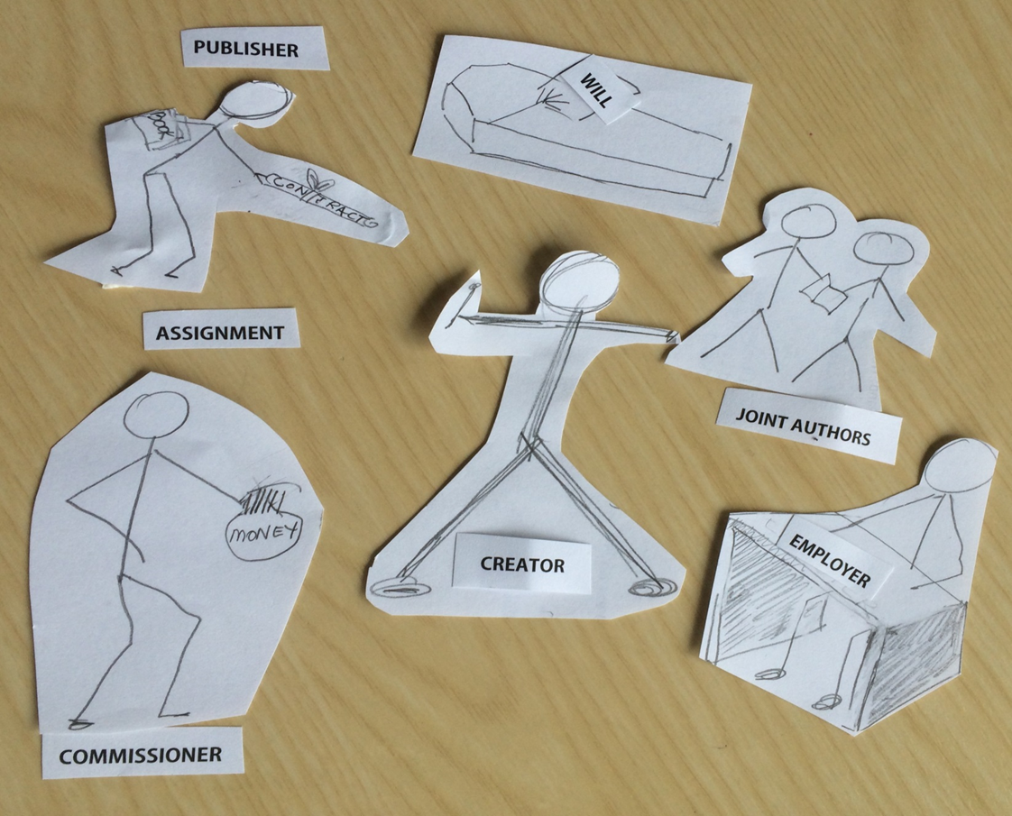
Who owns copyright?
Notes:
The creation of a copyright work is fairly straightforward, however ownership of copyright is not straight forward.
Think about your most recent piece of written work and think who might own that – is it you, your employer, a co-author, a publisher. It may be some guidelines, instructional material, or a journal article. If you wrote the work in the course of your employment is will depend on your institutions intellectual property policy.
At the University of Auckland IP created by staff and students policy –
Monograph, journal article, book or conference paper are owned by staff and not just academic staff.
Dramatic works
Words of a song
Musical work
Work of fine art
Instructional material will be owned by staff except where expressly and separately commissioned by the University independently of any employment agreement copyright in the following works belongs in the first instance to the staff member who created i:
Students own:
Their theses, dissertations and other assessable works unless they have entered into a funding agreement in which they agree to assign copyright to the funder. In one instance I am aware of students who were working in one institution (given a desk and a project) the institution asked the students to assign copyright to the institution.

Slide 4
Collaborations
Copyright in co-authored works is jointly owned – can’t assign the work without co-authors permission
To be a co-author, a contribution is not distinct from the other authors’ contributions.
The owner of copyright is the person who wrote the work.
Just having a name on the work doesn’t confer ownership.
Notes:
For co-authors copyright will be jointly owned and the work cannot be assigned without the permission of co-authors.
The owner of copyright is the person who wrote the work.
To be a co-author, a contribution is not distinct from the other authors’ contributions.
Just having a name on the work doesn’t confer ownership.

Slide 5
Ownership of data
No copyright in:
ideas
facts (data), but copyright in a compilation of facts

Slide 6
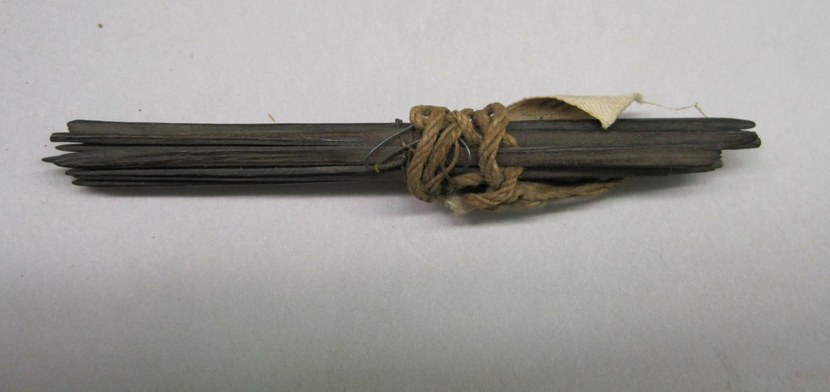
Copyright =
Bundle of rights
http://cdn2.brooklynmuseum.org/images/opencollection/objects/size2/CUR.36.713.jpg
Notes:
In the case of scholarly written works,
making multiple copies for educational purposes;
making derivative works,
abstracting parts of it for citation or quotation elsewhere
translations
Making it available digitally
Publishing it in hard copy
http://www.openoasis.org/index.php%3Foption%3Dcom_content%26view%3Darticle%26id%3D550%26Itemid%3D372

Slide 7
Moral rights
Sections 94 – 97- Right to be identified as the author whenever a work is commercially published or copies issued to the public– must be asserted
Creative works are viewed as an extension of the author’s personality
Notes:
Moral rights are not assigned to the publisher.
Alongside the right to be attributed whenever the work is published,
the author can object to derogatory treatment of her work, that brings the author into disrepute. Very difficult to prove.
Sections 94 – 97- Right to be identified as the author whenever a work is commercially published or copies issued to the public– must be asserted
Creative works are viewed as an extension of the author’s personality

Slide 8
Asserting ©
All rights reserved
No part of this work may be reproduced or transmitted in any form or by any means, or stored in a retrieval system of any nature, without the written permission of the copyright holder.
No part of this work may be modified without the written permission of the author.
No part of this work may be exposed to public view in any form or by any means, without identifying the creator as author.

Slide 9
What do publishers need?
Assignment of copyright; or
Licence - Exclusive v Non-exclusive Licence
Literary work
Data
Images and diagrams
Notes:
So when it comes to negotiating with the publisher it important to remember that they will want an assignment of copyright so they can to publish the work, make changes to the text to meet editorial needs, to licence the work to different platforms they may wish to publish on etc. If the technology changes they can publish the work in the new format or using a new technology.
This means they prefer an assignment – it makes publishing the work much easier, but it does mean if you are a PhD student for example you cannot include the work in the thesis without going back to the publisher, or you cannot distribute the work to colleagues or students.
The publisher does not however need an assignment of copyright to be able to publish the work. The author can grant the publisher a licence – a non exclusive licence to publish, with an agreement not to upload the work to an institutional repository or personal website within a certain period that the publisher needs to market and sell the work. The publisher may ask for an exclusive licence. Check that the publisher doesn’t want an exclusive licence because if they do, it is virtually the same as an assignment.
The work may have three different copyrights, copyright in the written text, a separate copyright in any illustrations or diagrams and the data will be protected as a compilation even if the individual facts are not protected.

Slide 10
Retaining rights to reuse work
Sergey Klimpkin http://www.freeimages.com/photo/the-stacks-of-books-1630957
Notes:
One of the most important things for a researcher is to retain the rights to use your own work. Typically publishers will ask you to assign copyright to them. This means you have no rights to use that work again, to build on that work, to quote large extracts of text from that work.
It is possible to negotiate with the publisher to retain some of the rights you need.
Think about what you might want to do in the future with your work, bearing in mind that by assigning you retain no rights to copy your own works and that your rights are a bundle of rights – which rights would you want to retain:

Slide 11
Examples
deposit on own website or institutional repository
rights revert to Author if Article rejected
use in further research and teaching
incorporating in other works by the Author or compilation of the author’s works
scholarly sharing
use in a thesis or dissertation
Notes:
To quote from the work;
Use part of the work or a different or extended version of the work as a basis for a future publication
Make copies to share with students and colleagues
Include in thesis
Place work in personal or institutional repository
,
A 2008 survey indicated that there had been a drop in the number of publishers requiring copyright transfer from the author from 83% in 2003, to 61% in 2005 and to 53% in 2008. In 2005, 3% of publishers were found not to require any form of written agreement with the author and this had increased to almost 7% by 2008 (1).

Slide 12
Use figshare to store your
Data; and
Diagrams
make them available under a CC-BY licence

Slide 13
Key messages
Copyright arises automatically
Assigning copyright to the publisher means authors have no further rights to use that work
Negotiate before submission of work for publication
Retain a copy of the publishing contract
Notes:
Things to consider
One of the most important rights to retain is the right of reversion. You see these clauses mostly with books rather than journal articles. If the work goes out of print then the author needs to have the rights revert to her. Example textbooks. Academics often write textbooks and assign the texts to students.

Slide 14
Questions???

